Slide 1

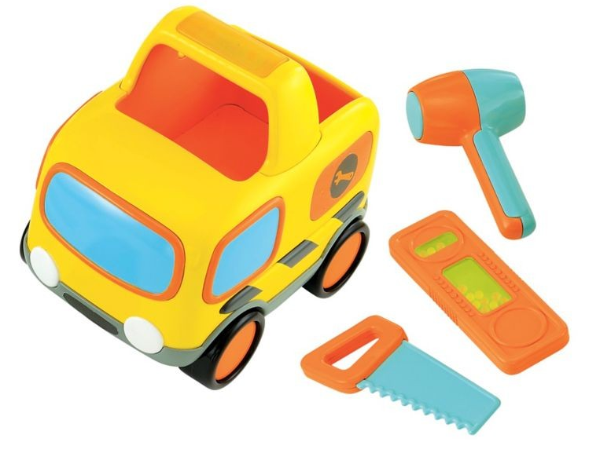
Lights and Sounds Tool Van
Toy Name
Lights and Sounds Tool Van
Manufacturer
Early Learning Centre
Age
18 – 36 months
Parts
Tool Van
Hammer
Saw
Spirit Level
Develop Skills
Fine Motor
Imagination
Cognitive
Practical Life
How it Works
Dengar suara ‘beep beep’ dan lihat lampu-lampu menyala ketika tombol ditekan atau ketika mobil didorong. Doronglah mobil ke tempat yang perlu pembangunan atau perbaikan dengan memotong dan memalu.
-
‘Beep beep’ hear the engine sounds and see the flashing lights as you push the button or push the van across the room. Zoom off to build, fix, saw, and hammer.
How To Clean
Simply clean using a cloth that has been sprayed with non-toxic anti bacterial solution
Warning
Do not wash/soak in water
Store in a dry place
Keep out of direct sunlight

